Slide 1

8 Week SQL Challenge
Case Study #4 Data Bank

Slide 2
Introduction
There is a new innovation in the financial industry called Neo-Banks: new aged digital only banks without physical branches.
Danny thought that there should be some sort of intersection between these new age banks, cryptocurrency and the data world…so he decides to launch a new initiative - Data Bank!
Data Bank runs just like any other digital bank - but it isn’t only for banking activities, they also have the world’s most secure distributed data storage platform!
Customers are allocated cloud data storage limits which are directly linked to how much money they have in their accounts. There are a few interesting caveats that go with this business model, and this is where the Data Bank team need your help!
The management team at Data Bank want to increase their total customer base - but also need some help tracking just how much data storage their customers will need.
This case study is all about calculating metrics, growth and helping the business analyze their data in a smart way to better forecast and plan for their future developments!

Slide 3
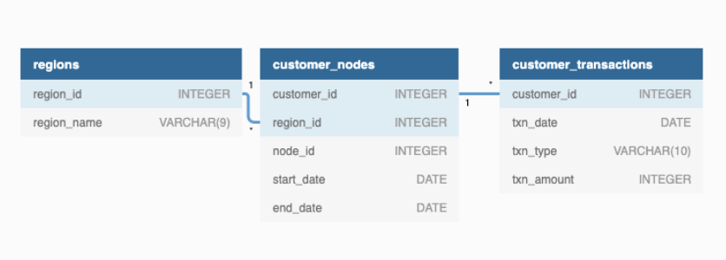
Entity Relationship Diagram

Slide 4
A. Customer Nodes Exploration
How many unique nodes are there on the Data Bank system?
What is the number of nodes per region?
How many customers are allocated to each region?
How many days on average are customers reallocated to a different node?
What is the median, 80th and 95th percentile for this same reallocation days metric for each region?

Slide 5
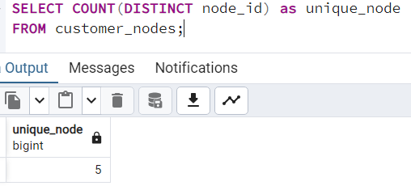
1. How many unique nodes are there on the Data Bank system?
There are 5 Unique nodes present in Data Bank System

Slide 6
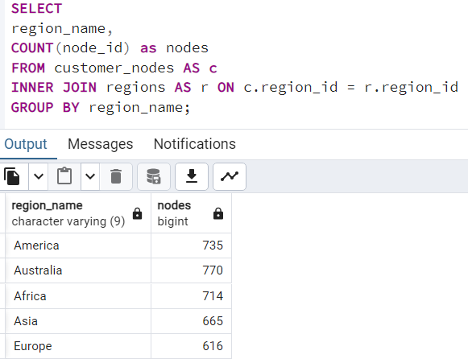
2. What is the number of nodes per region?

Slide 7
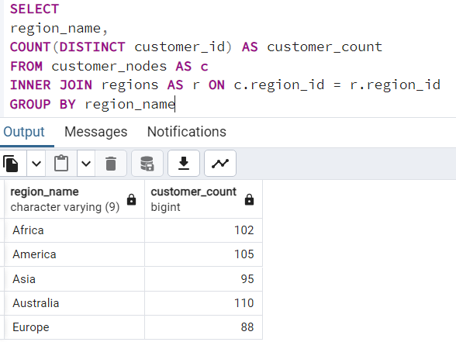
3. How many customers are allocated to each region?

Slide 8
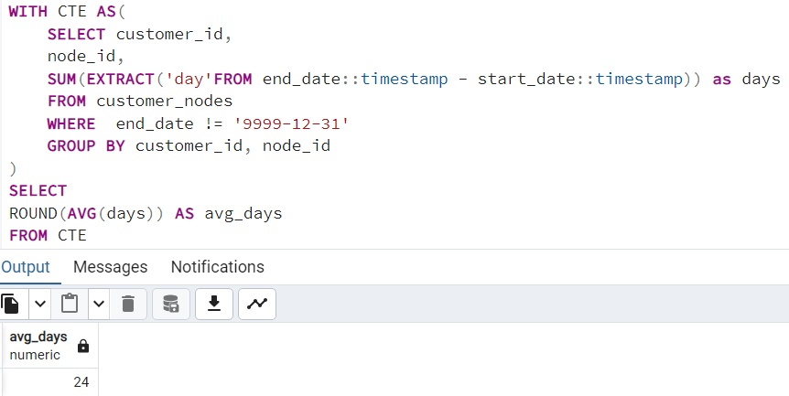
4. How many days on average are customers reallocated to a different node?
On an Average each customer spent 24 days to reallocate to a different node.

Slide 9
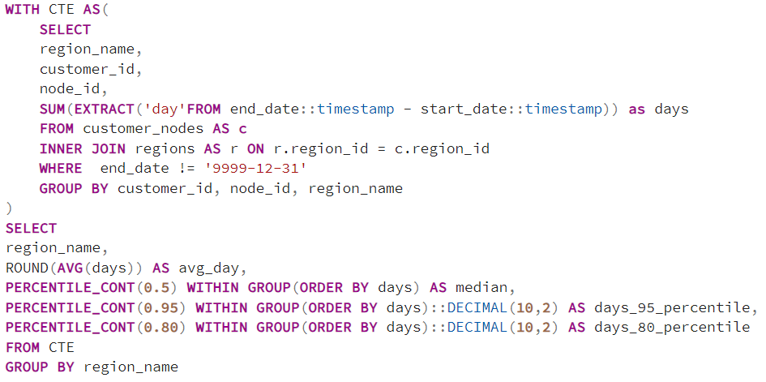
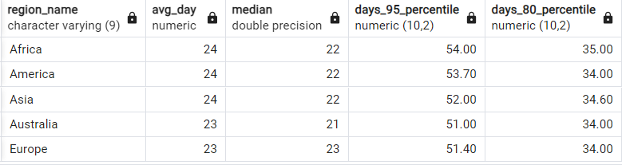
5. What is the median, 80th and 95th percentile for this same reallocation days metric for each region?

Slide 10
B. Customer Transactions
What is the unique count and total amount for each transaction type?
What is the average total historical deposit counts and amounts for all customers?
For each month - how many Data Bank customers make more than 1 deposit and either 1 purchase or 1 withdrawal in a single month?
What is the closing balance for each customer at the end of the month?

Slide 11
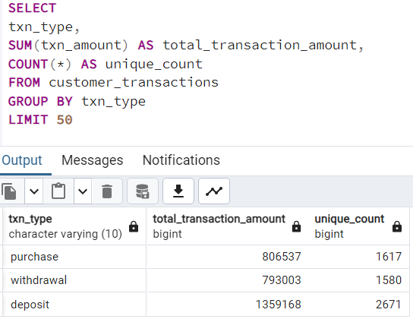
1. What is the unique count and total amount for each transaction type?

Slide 12
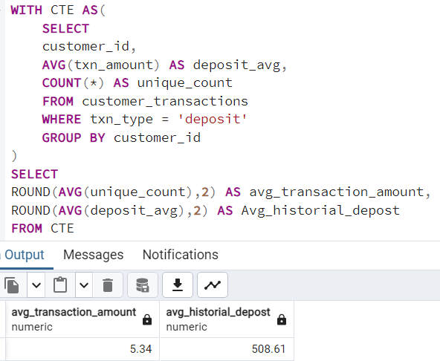
2. What is the average total historical deposit counts and amounts for all customers?

Slide 13
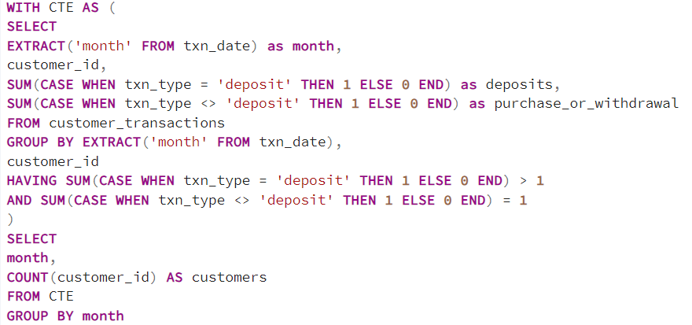
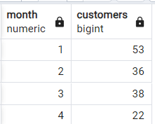
3. For each month - how many Data Bank customers make more than 1 deposit and either 1 purchase or 1 withdrawal in a single month?

Slide 14
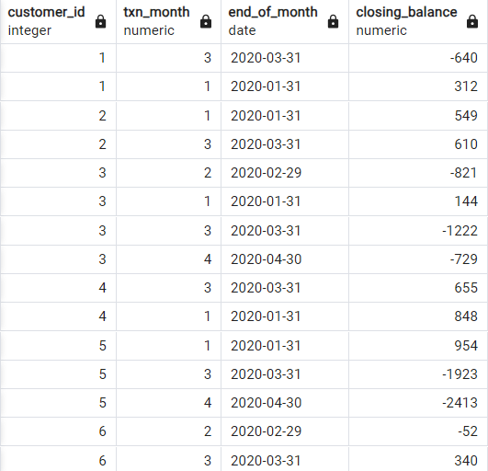
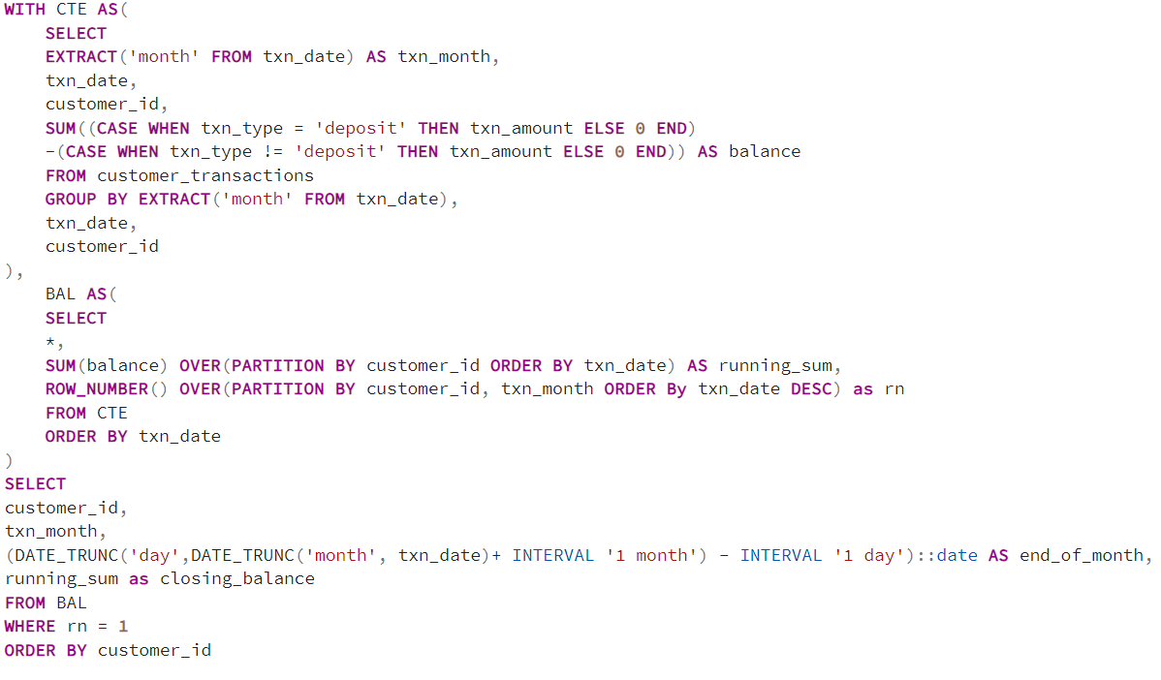
4. What is the closing balance for each customer at the end of the month?

Slide 15
C. Data Allocation Challenge
To test out a few different hypotheses - the Data Bank team wants to run an experiment where different groups of customers would be allocated data using 3 different options:
Option 1: data is allocated based off the amount of money at the end of the previous month
Option 2: data is allocated on the average amount of money kept in the account in the previous 30 days
Option 3: data is updated real-time
For this multi-part challenge question - you have been requested to generate the following data elements to help the Data Bank team estimate how much data will need to be provisioned for each option:
running customer balance column that includes the impact each transaction
customer balance at the end of each month
minimum, average and maximum values of the running balance for each customer
Using all of the data available - how much data would have been required for each option on a monthly basis?

Slide 16
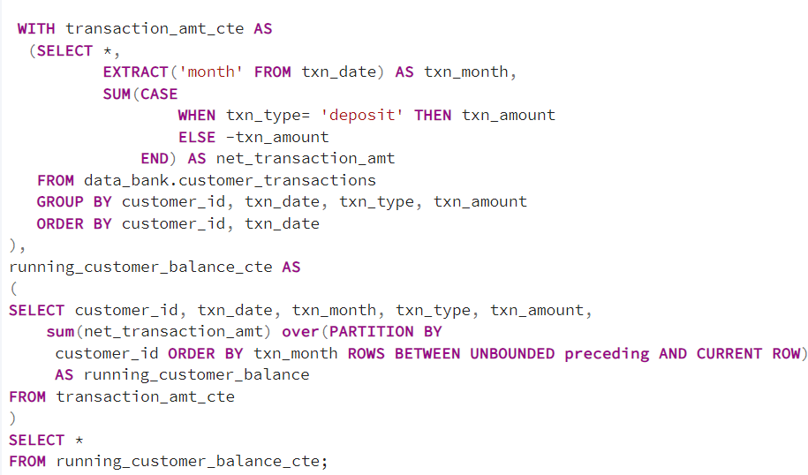
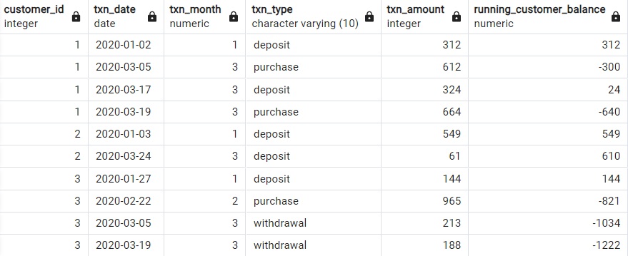
Running customer balance column that includes the impact each transaction

Slide 17
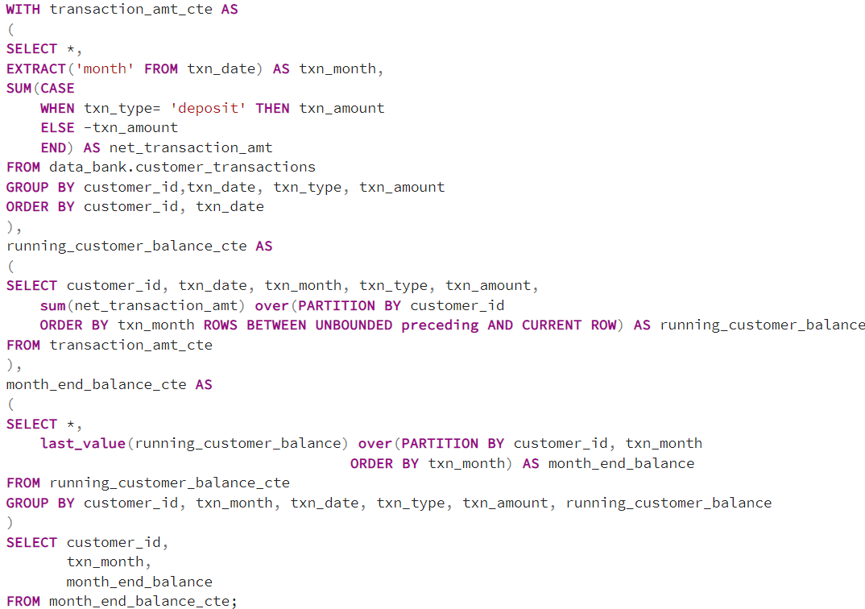
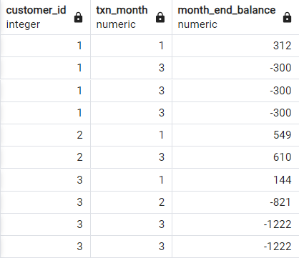
Customer balance at the end of each month

Slide 18
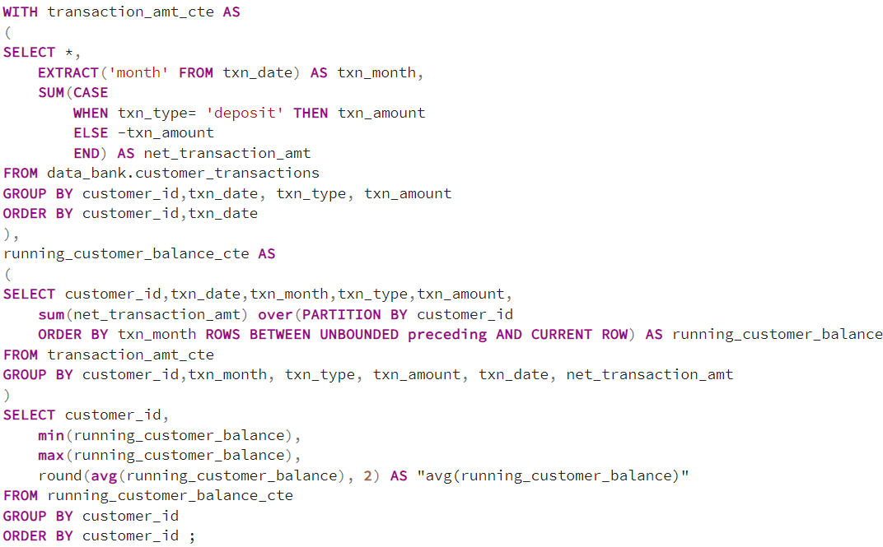
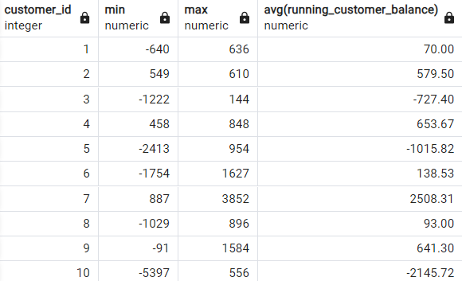
Minimum, average and maximum values of the running balance for each customer

Slide 19
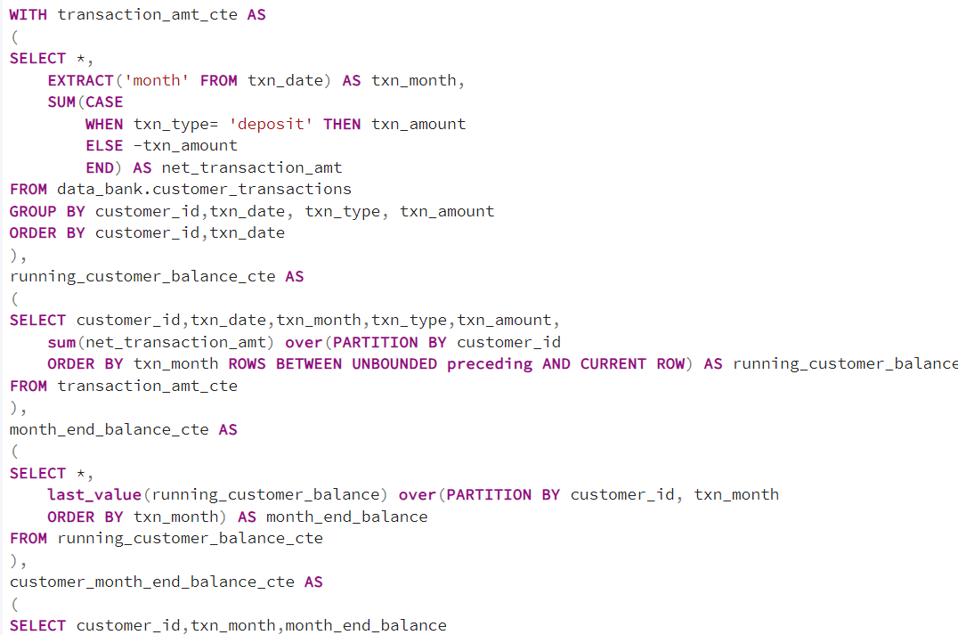
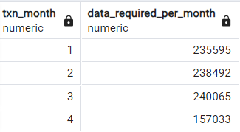
Option 1: Data is allocated based off the amount of money at the end of the previous month
How much data would have been required on a monthly basis?

